Slide 1


PREDICTION MODEL USING FACIAL FEATURES
RAGHAV MATHUR,HARSHIT PALIWAL AND VEDANT KUKRETI
15103098,15104042 AND 15104061
SUPERVISED BY DR. SHIKHA JAIN

Slide 2
TABLE OF CONTENT
1
A LITTLE HISTORY
4
FLOWCHART
Timeline of our project development
The flowchart of our project
2
ABOUT OUR PROJECT
5
RESULTS
Future uses of integration of our project in real life examples
The final results and accuracy we achieved with our project
3
6
CLASSIFICATION GROUPS
POTENTIAL APPLICATIONS
The categories in which we are classifying our data
Future uses of integration of our project in real life examples

Slide 3
ABOUT OUR PROJECT
The problem of Age classification from the facial images is very captivating, but also the demanding one because age of human varies based on the various factors which may be internal factors or external factors. Internal factors vary age include gender, genetics etc. while the external factors that affect the age include lifestyle, drugs, ethnicity, etc. and these two factors could make it complicated to perfectly formulate the human growth pattern. The facial ageing estimation process that has been developed obtained a high accuracy rate for the baby faces than the adult faces, but for the adults this process has been a complicated task due to the occurrence of different patterns of ageing, internal factors, skin texture, and external factors for some years. One of the main challenges of the age classification is the accurateness level, which is due to the intricacy of the human ageing pattern. So, it is not only adequate to classify the human age, but also essential to predict it as precisely as possible. Another important issue that is relevant to the age prediction problem is the age-groups range and this parameter is a key aspect as different characteristics of ageing pattern appear in different age-groups, hence the system got trained to cope with specific ranges might not be relevant to a more diverse range of age-group. Therefore, in this study, we are encountering the human age- group prediction task between the young, adult, and old to an acceptable degree of classification accuracy based on facial images.

Slide 4
A LITTLE HISTORY
HAAR FEATURE EXTRACTION
HOG FEATURE EXTRACTION
REAL TIME IMPLEMENTATION
Six features extracted to gain insights of face using Viola Jones algorithm
Upgraded to HOG feature extraction having 900 features of the face
Implemented real time prediction to further improve usability in applications
SEPT 18
NOV 18
JAN 19
MARCH 19
MAY 19
HAAR + KNN CLASSIFICATION
HOG + NN
Classified using KNN classification and achieved 75% accuracy
Implemented neural networks to obtain more than 90% accuracy

Slide 5
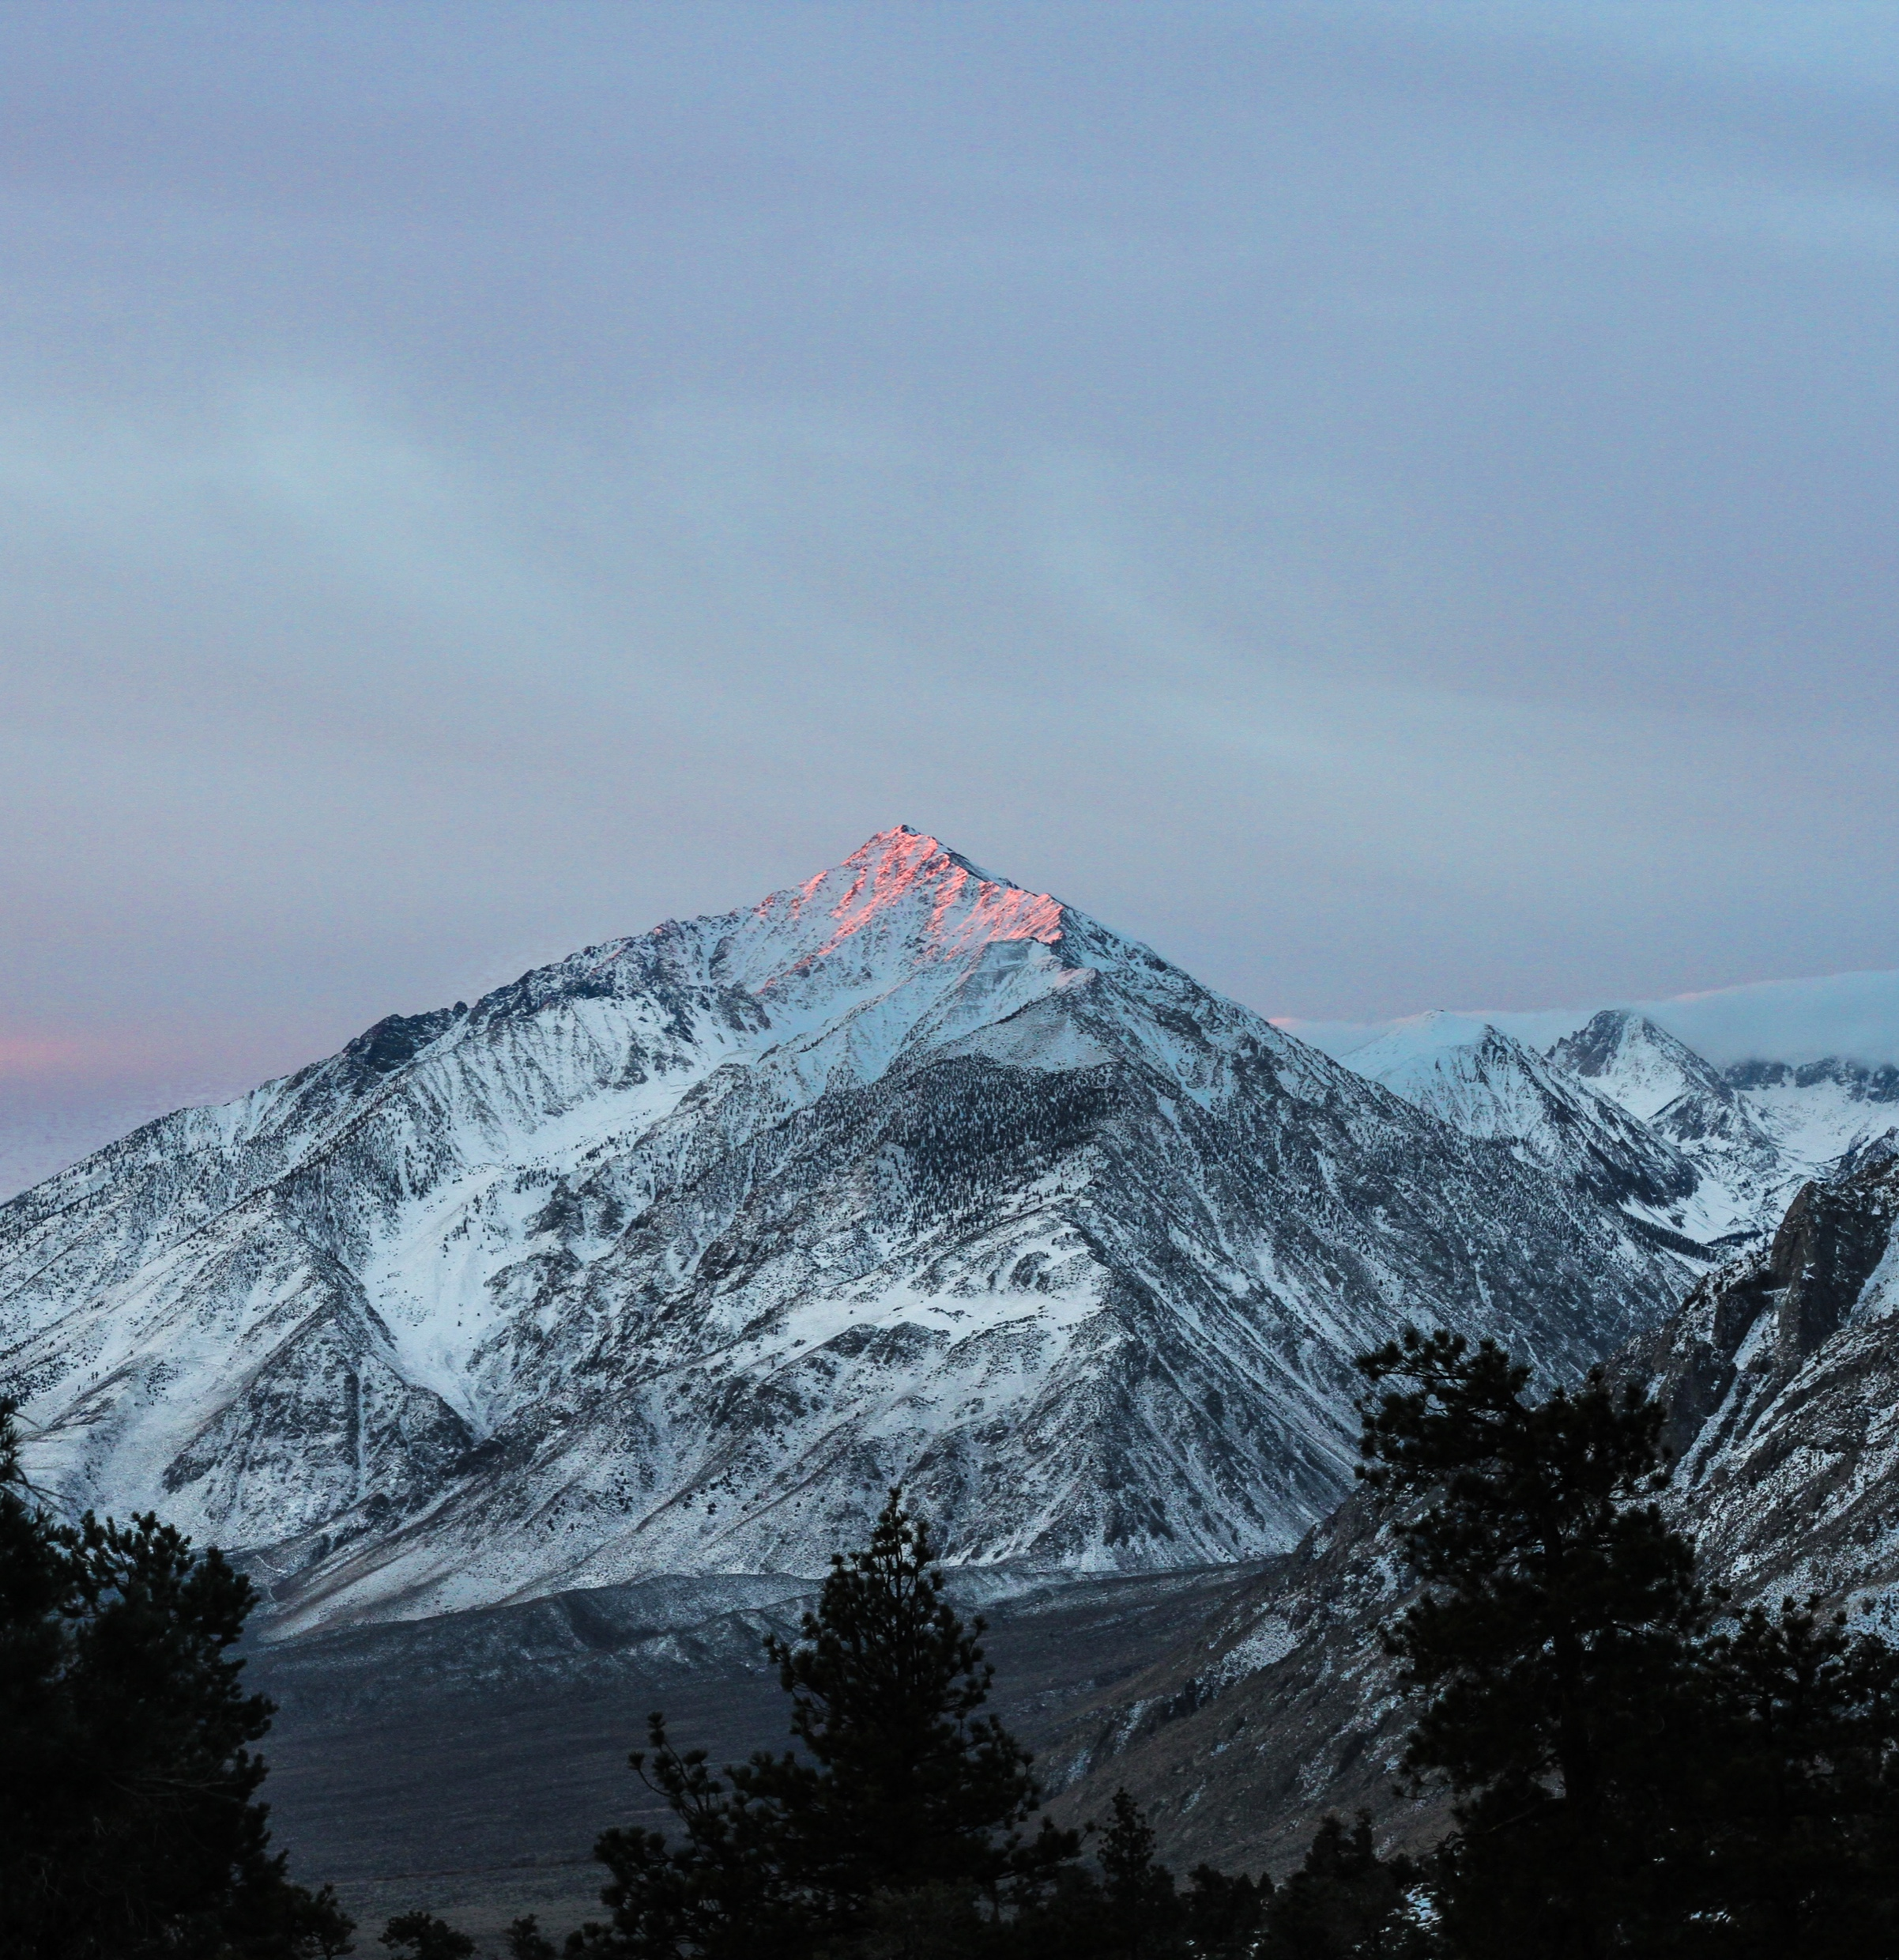
POTENTIAL APPLICATIONS
FUTURE PROJECTS
AGE CLASSIFICATION
Collection of age related data for marketing analytics in all fields.
AGE RESTRICTED WEBSITES
Websites with restricted access can have enhanced security with effective child block
AGE RESTRICTED KIOSK
Public area kiosk for cigarettes would become automated to serve to the right age group
LIQOUR SHOP
Online liquor websites can use this to prevent underage people from buying.

Slide 6
CLASSIFACTION GROUPS
CHILD
ADULT
SENIOR
CHILDREN
ADULT
SENIOR
LESS THAN 18 YEARS OLD
BETWEEN 18 TO 60 YEARS OLD
ABOVE 60 YEARS OLD

Slide 7
FLOWCHART
INSERT IMAGE
HYBRID SYSTEM
Add The Image Using The MATLAB UI
Classifying The Image On The Basis Of Geometric And Wrinkle Features
AGE GROUP CLASSIFICATION
CLASSIFIED GROUP
INPUT IMAGE
FACIAL FEATURE EXTRACTION
EXTRACT FEATURES
RESULT
First We Used Haar Feature Extraction And Then Upgraded To Hog Features To Improve The Prediction
Image Classified Into One Of The Three Categories

Slide 8
RESULTS
75 %
93 %
HAAR + KNN
HOG + NUERAL NETWORK
LAST SEMESTER
THIS SEMESTER

